Slide 1

Spotify Project
By: Emily Wang and Marco Tortolani
Notes:
Marco

Slide 2
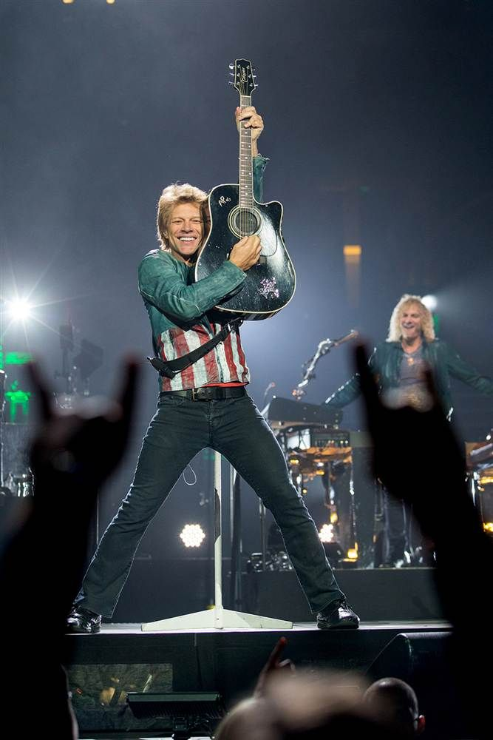
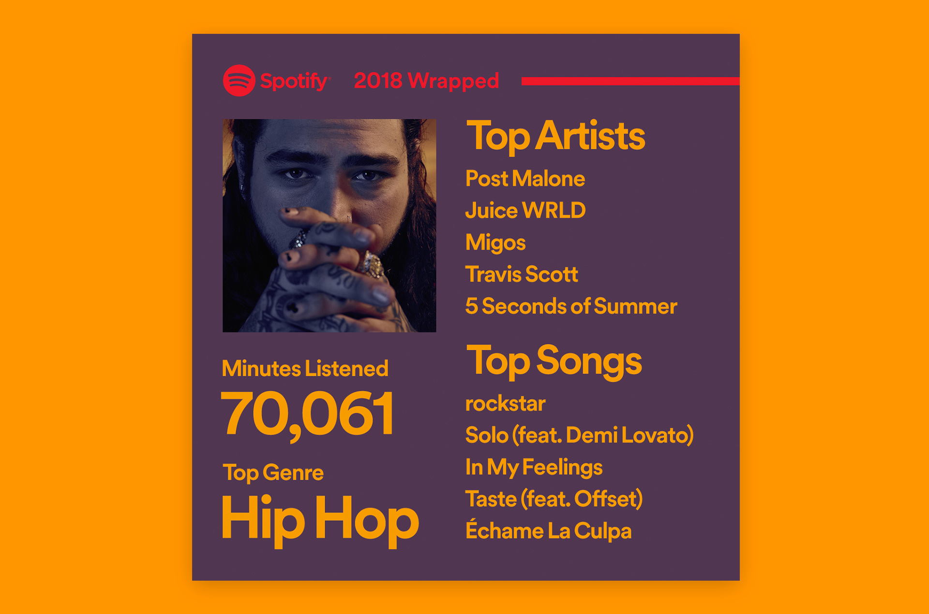
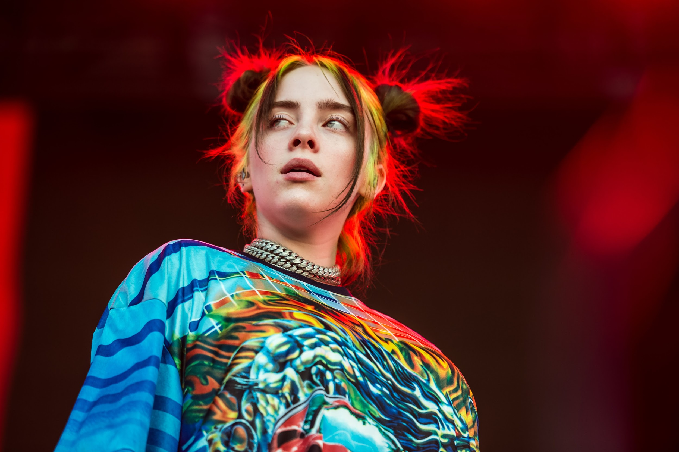
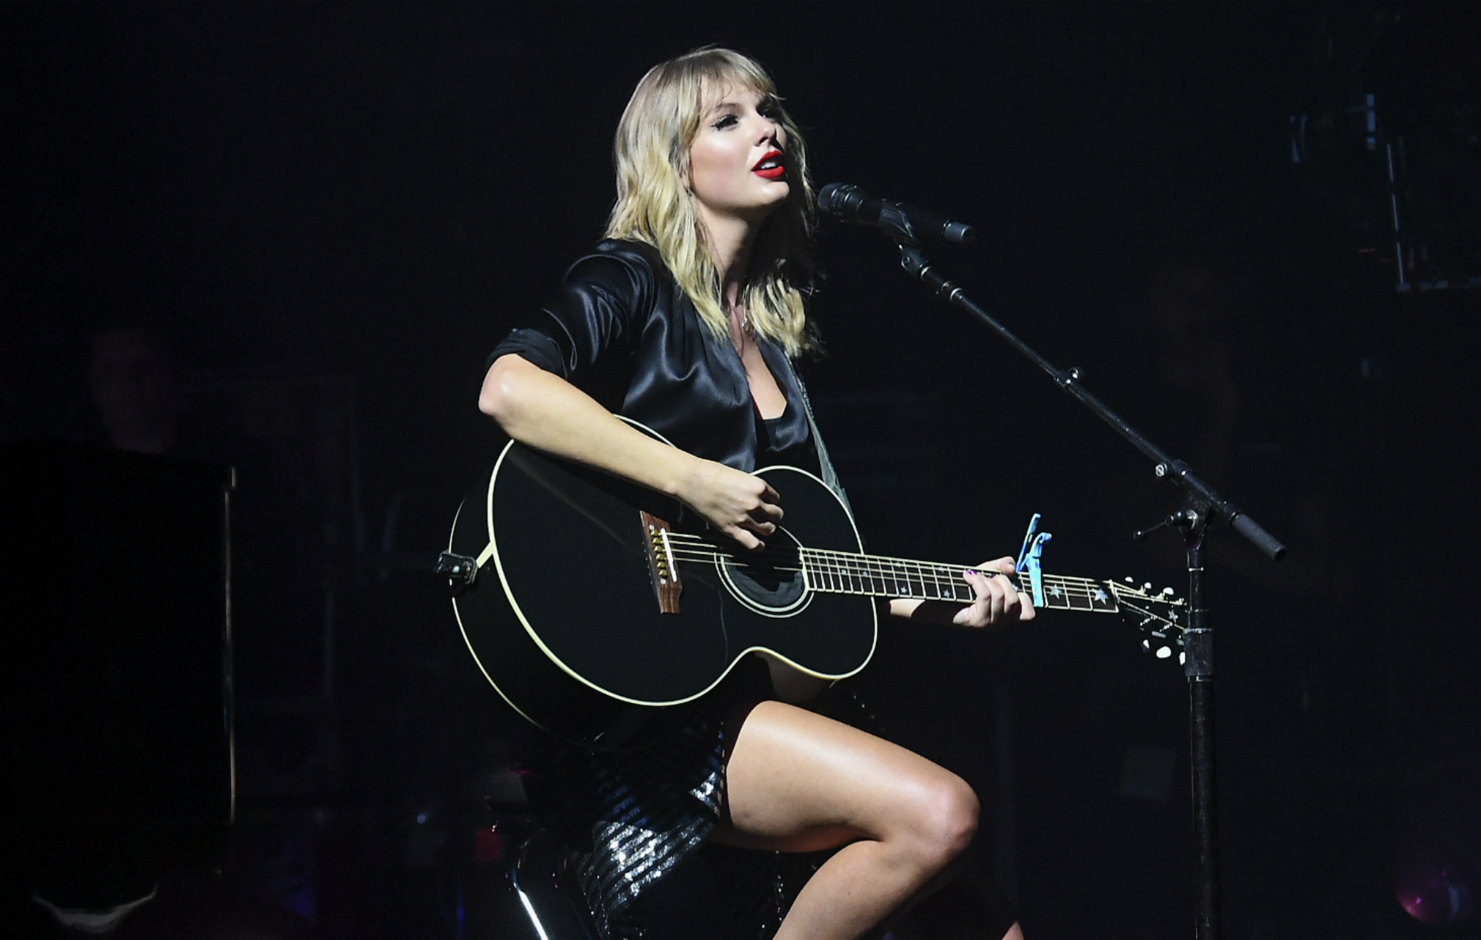
Background
Notes:
EMILY
Have you ever wondered how your favorite artists release albums? What the behind-the-scenes of the process are like? The amount of time, money, and effort that goes into creating some of your favorite songs?

Slide 3
$500,000-$2,000,000
Years of Time, Effort, $
$11+ billion
To release new album
In making a popular album
Revenue from US Music Industry
Credit: Stop the Breaks, “How Much Do Record Labels Spend On Marketing Their Artists”
Notes:
EMILY
Artists and record labels spend from hundreds of thousands to millions of dollars to record, produce, release, and market a new album
This process often take artists several years to complete from start to finish
Overwhelming for artists, especially prospective new artists
With all the time, effort and money spent on producing an album in the hopes of having people listen, it would be extremely helpful for artists to understand how to maximize the popularity of their songs before record companies spend the money to release them
https://www.stopthebreaks.com/diy-artists/how-much-do-record-labels-spend-on-marketing-their-artists/

Slide 4

Target Group:
Marco’s Brother:
Franco Tortolani
Go listen!
Youtube: FrancoMusicOficial
Notes:
MARCO
Consider Marco’s brother, Franco; Franco wants to release a song
As an aspiring artist, he doesn’t know how to best create a song that will reach as many listeners as possible and help jumpstart his music career

Slide 5
How do we help artists maximize the popularity of their songs?
Notes:
EMILY
“How do we help artists utilize various elements of songs to create an intended effect?”
For instance, if an artist wanted to make their song sound more “positive” or “happy”, which traits would they have to change? For example, would they need to change the loudness of their track?
How do artists help produce songs that we, as listeners, want to hear?

Slide 6
Our Data Set
Popularity
Danceability
Energy
Instrumentalness
Liveness
Speechiness
Valence
Year
Notes:
Spotify has been collecting data on its users’ listening habits and storing this information in its API
Contains more than 160,000 songs collected from Spotify Web API
Collected data from Yamac Eren Ay’s Kaggle dataset “Spotify Dataset 1921-2020, 160k+ Tracks”
Popularity: ranges from 0 to 100 (based on total number of plays a track has had and how recent those plays are)
All other traits range from 0 to 1
Danceability: how suitable a track is for dancing based on combo of musical elements like beat strength, tempo, rhythm stability, etc.
Energy: a measure of intensity and activity within a track
Instrumentalness: predicts whether a track contains no vocals
Liveness: detects the presence of an audience in the recording
Speechiness: detects presence of spoken words
Valence: describes the musical positiveness conveyed by a track (high valence sounds happy, cheerful, positive)
Year: year track was released (ranges from 1921-2020)

Slide 7
Methods
Notes:
EMILY
How fast do songs lose popularity over time?
Which variables have the highest impact on the final popularity rating?
What values of musical traits obtains the highest average popularity rating?
How do traits relate to each other? What are the tradeoffs between traits?
Popularity over Time
Popularity vs. Specific Trait
Trait vs. Trait
Correlation between Popularity & Trait

Slide 8
When should my album drop?
1
Notes:
MARCO

Slide 9
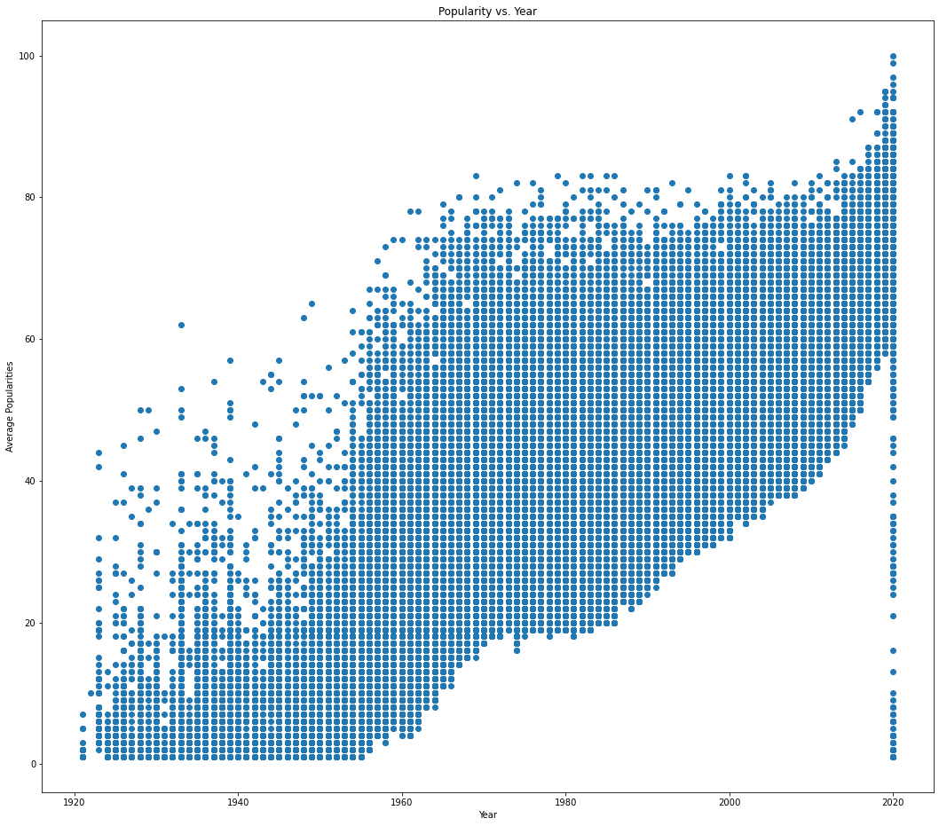
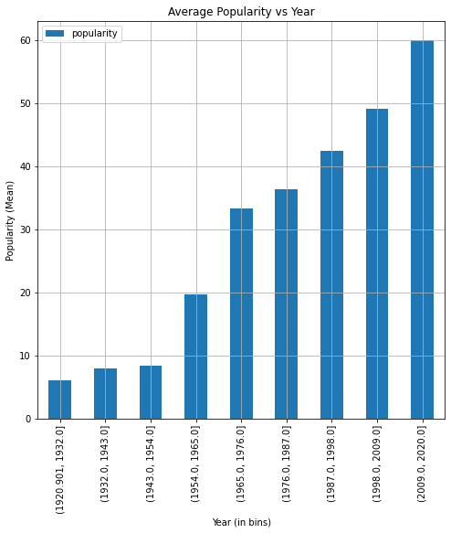
Visualized Music Aging
1 year to reach the top / 60 years to stay in the game
Notes:
MARCO
What do we notice about the aging of your song?
Your song can only reach above 90 popularity if it is the first year or two after its release. After that, spotify rarely gives it a high popularity rating. Aka dont expect your old songs to make a sudden comeback
Popularity decline occurs quickly at first, yet begins to slow down and steady as you reach 3-4 decades old. However, once your song is 50 years old or more, spotify considers it almost dead and popularity plummets
The floor of the popularity averages is steeper than the roof. A good song can still maybe make it after a couple of years, but bad songs are more likely to be thrown away quickly.

Slide 10
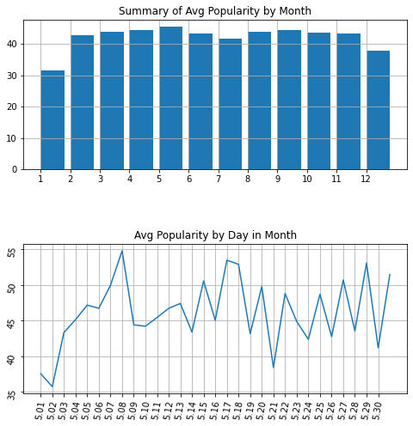
If you’re not releasing on May 8th then you’re not cool anymore.
Other top options:
April 27th
September 27th
August 9th
Notes:
Emily
We made a function where you input the month and it returns the average popularity for each day of the month
Picking the right date can affect your song’s popularity by up to 20%

Slide 11
How should I be writing songs?
2
Notes:
Marco

Slide 12
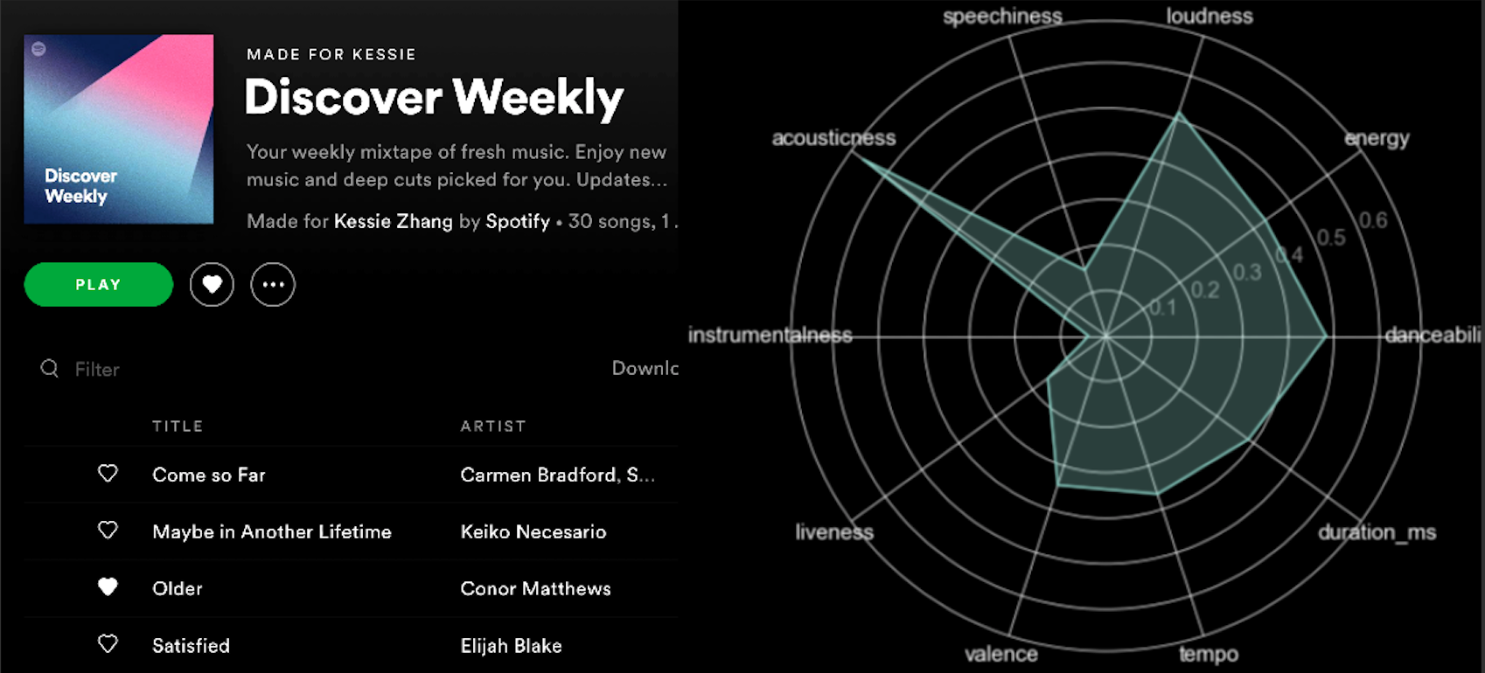
Spotify knows what you like.
How do we give it what it wants?
Credit: Kessie Zhang, towardsdatascience.com
Notes:
MARCO
Spotify already keeps track of all these different variable metrics for every song you make. This can help track who it should present it to and what we can expect from the audience
We need to use these metrics to draw some conclusion on how an artist can become successful on spotify

Slide 13

We’re in this industry to be
POPULAR
Credit: Wallpaperflare.com
Notes:
MARCO
Although other metrics are more important to some users and less important to other, for our second objective, we’re going to assume Franco only cares about producing popular songs

Slide 14
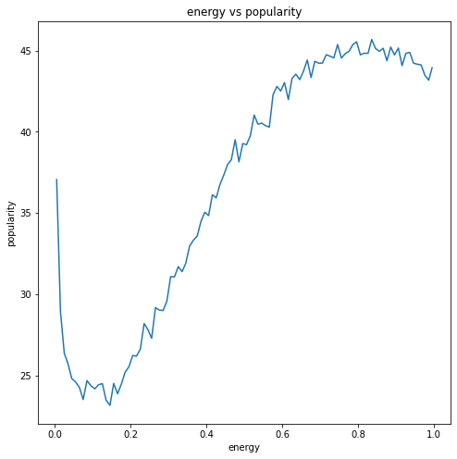
Trait vs. Popularity
Notes:
EMILY
One method we created to better understand and clearly visualize the relationship between any given trait and popularity was a popularity grapher
You input the trait and a line graph of that trait plotted against popularity is shown
Shows general trends between a trait and popularity
We also created a method that allows you to find a trait’s value that returns the highest popularity (finds the x coordinate that gives you the maximum of the graph) so you can optimize specific traits
For instance, inputting energy allows you to find that an energy value of 0.835 is optimal to have the highest average popularity

Slide 15
What traits should I focus on?
3
Notes:
Marco
Explore how various traits may affect each other and affect the overall quality of a song

Slide 16
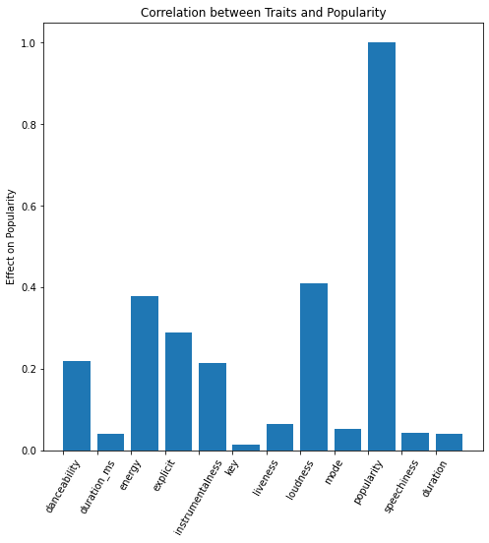
Changing key won’t score you any brownie points with Spotify.
Notes:
Marco
We created a graph to compare how strongly various traits correlated with popularity
The graph shows that variables with a stronger correlation include loudness and energy with an r^2 value (correlation coefficient) of about 0.44 and 0.38, respectively
Not necessarily causation; i.e. songs that are more explicit will not necessarily be more popular; instead, songs that are more explicit may tend to be louder and have more energy, which seem to correlate strongly w/ popularity

Slide 17
I can’t seem to balance my traits!
4
Notes:
Marco
When designing a song, you may not be able to optimize every single trait in your song to be perfect.

Slide 18
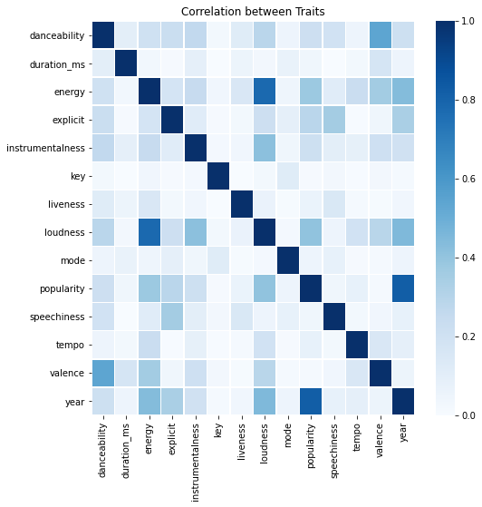
Trait Correlation Heatmap
Dang, this map is looking pretty hot!!!
Notes:
MARCO
In that case, we can use a heatmap to know which traits have a high correlation with popularity.
As shown by the heatmap, traits “loudness” and “energy” have a stronger correlation
“Popularity” and “year” do as well
This makes sense because as stated before, the popularity metric is dependent on the total number of plays a track has had and how recent those plays are
Since many people tend to listen to music released more recently, there is a strong correlation between these two traits
Danceability and valence:
Songs with a higher danceability value also seem to have higher valence (sound more “positive” and “happy”)

Slide 19
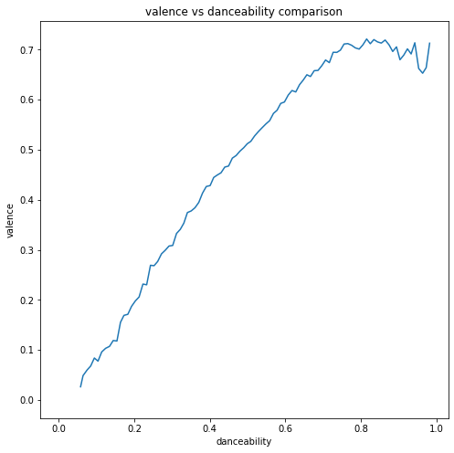
Trait Comparison
If you want your song to have energy, you better get ready to get loud!
Notes:
EMILY
We created a function that allows you to graph a trait against another trait to easily distinguish a pattern, if one exists
For instance, this graph shows that songs with a higher danceability value tend to have a higher valence value meaning
how suitable a track is for dancing based on combo of musical elements like beat strength, tempo, rhythm stability, etc. may affect the musical positiveness conveyed by a track
If an artist wants to make a song that sounds more “positive” and “happy” for the listeners, the artist may want to increase factors such as beat strength and tempo to make his song more suitable for dancing (for a higher danceability)

Slide 20
Results
Notes:
EMILY
From looking at 160,000 songs summed up through Spotify’s categorization, we made a summary of the most important factors songs should have

Slide 21
A “Perfect” Song
 | Desired Value | Importance
Accousticness | 0.0146 | Highest
Danceability | 0.9637 | Medium
Energy | 0.8354 | High
Instrumentalness | 0.9957 (~0.15) | Medium
Liveness | 0.0263 | Low
Loudness | -54.376 | High
Valence | 0.0007 (~0.35) | Lowest
Notes:
Marco
Accousticness: ranges from 0 to 1
Danceability: ranges from 0 to 1
Energy: 0 to 1
Instrumentalness: our function returned 0.9957; however, given the graph showing instrumentalness, this value is most likely an outlier because it did not follow the general trend showing that most songs without lyrics have a higher popularity
one song may have skewed the data to an outlandishly high popularity value
Liveness: 0 to 1 (detects presence
Loudness: ranges from -60 to 0 (measured in decibels). Decibels are a comparison unit, so whatever spotify used to set their 0DB mark must have been louder than any song we can make!

Slide 22
Lifespan of a Song
1-5 years old
5-60 years old
60+ years old
Notes:
MARCO
A song only has a couple years to reach 90+ popularity ratings
After 5 years, songs cap at 80+, but songs drop out and pull down the average
Songs over 60 years of age sharply drop in popularity over time

Slide 23
Tips and Prioritization
For more energy, pump up loudness
between -20 dB to -10 dB
Don’t upload simple voice-only songs!
Release songs on Fridays or Sundays
Notes:
Marco
The following traits have a strong correlation.
Here’s how you prioritize them:
Loudness and energy increase together, never worry about going overboard. Shoot for the moon.

Slide 24

Thank you!
Good luck on your next album drop :)
Notes:
Emily

